Slide 1
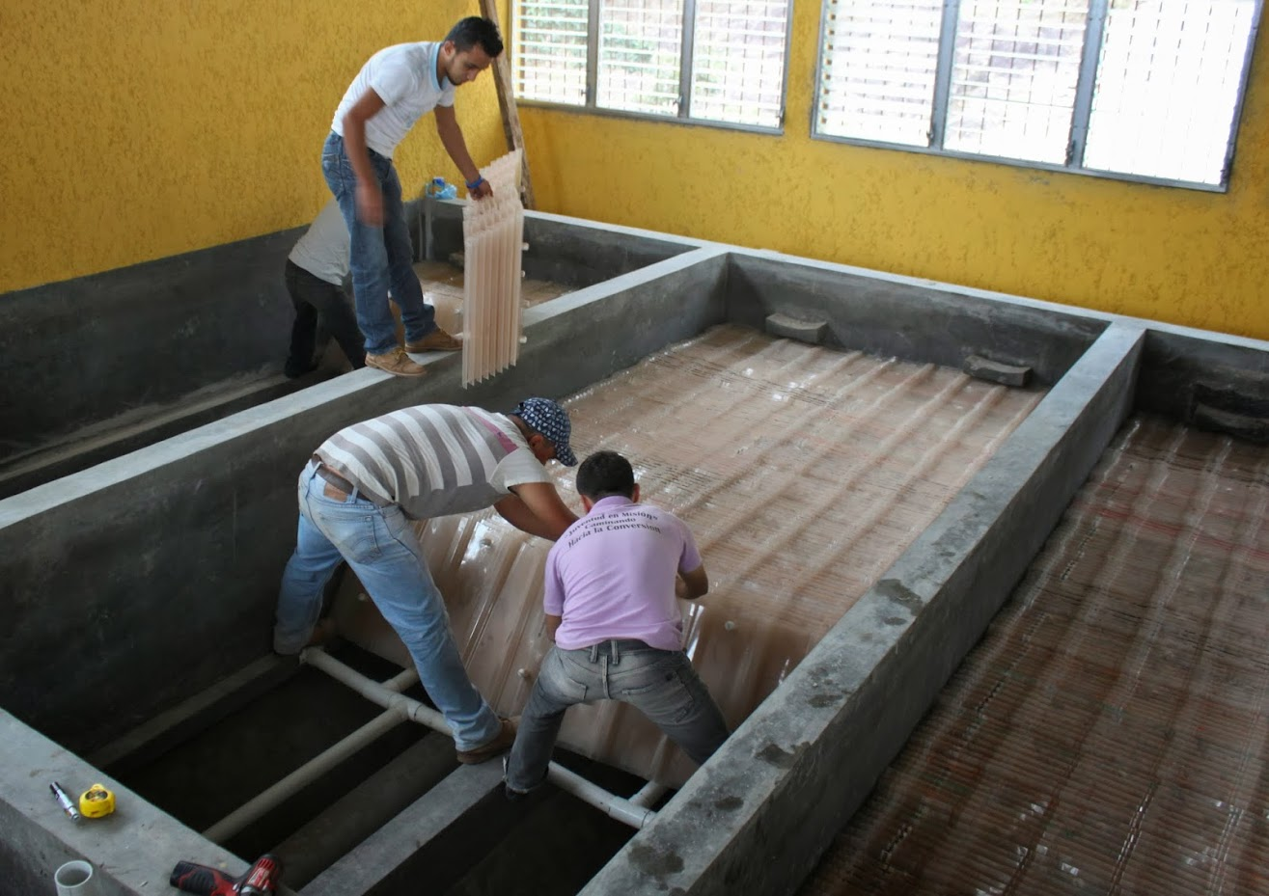
Sedimentation

Slide 2
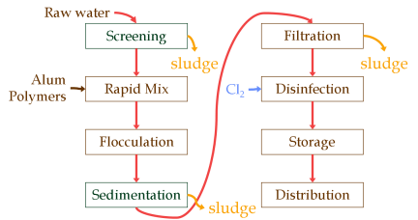
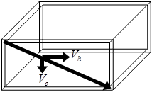
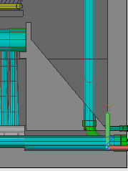
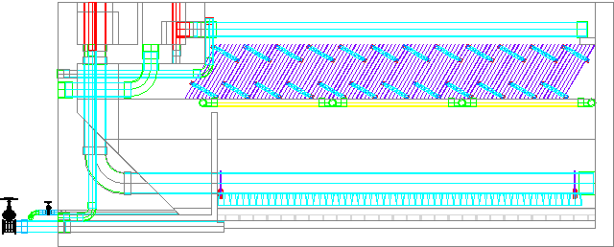
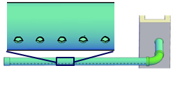
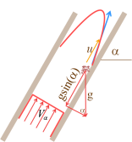
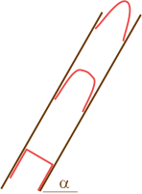
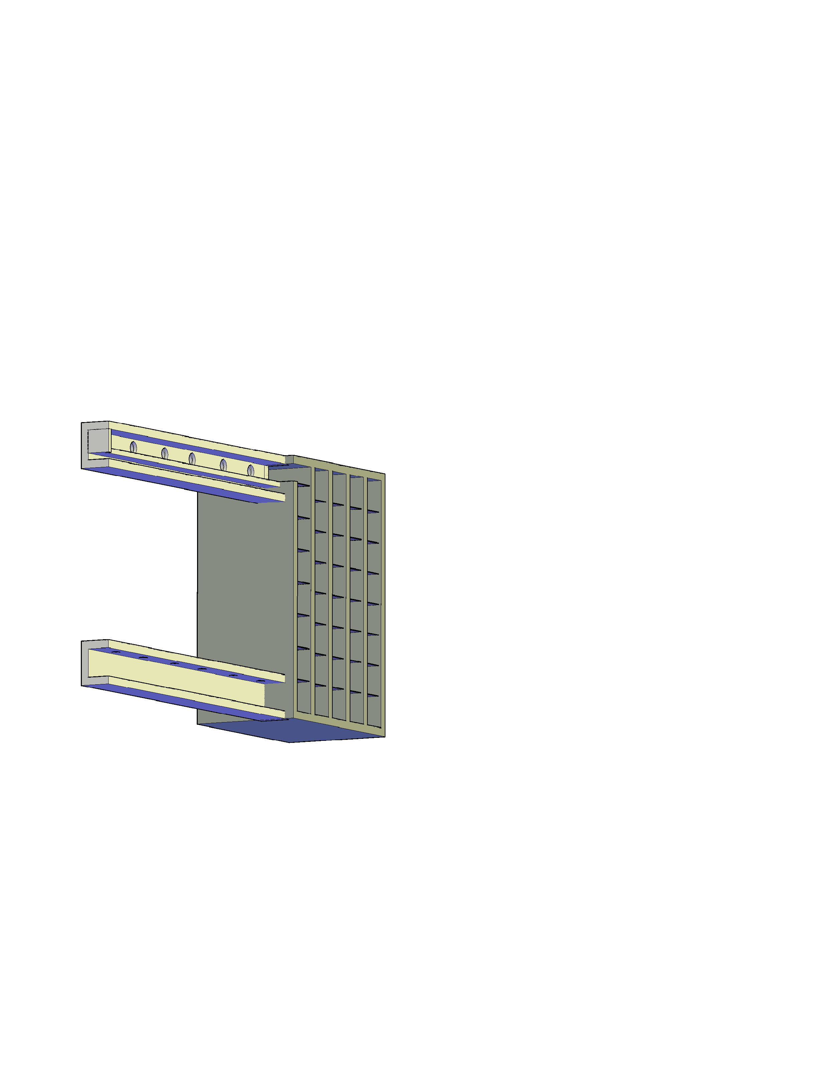
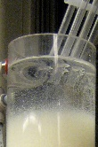
Topics
Introduction
Capture velocity
Plate settlers
Floc rollup
Entrance region
Floc blankets
Floc resuspension
Floc Hoppers
Delivering flocs
Minimum channel width
Scour velocity
Extras!

Slide 3
Conventional Surface Water Treatment
Raw water
Screening, grit removal, flow measurement
Filtration
sludge
sludge
Coagulant
Rapid Mix
Cl₂
Disinfection
Flocculation
Storage
Sedimentation
Distribution
sludge

Slide 4
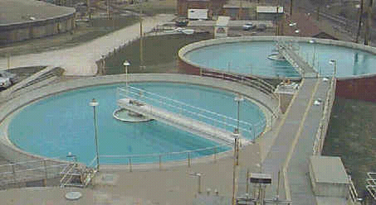
Evolution of Sedimentation
Uses gravity to separate particles from water
Often follows flocculation
Traditionally a big tank where particles settle
Combined processes including
Flocculation
Sedimentation
Sludge consolidation (reduce waste stream)
Notes:
I used to think of sedimentation as a simple process. It is actually a very complex process that has many failure modes and few examples of elegant designs.

Slide 5
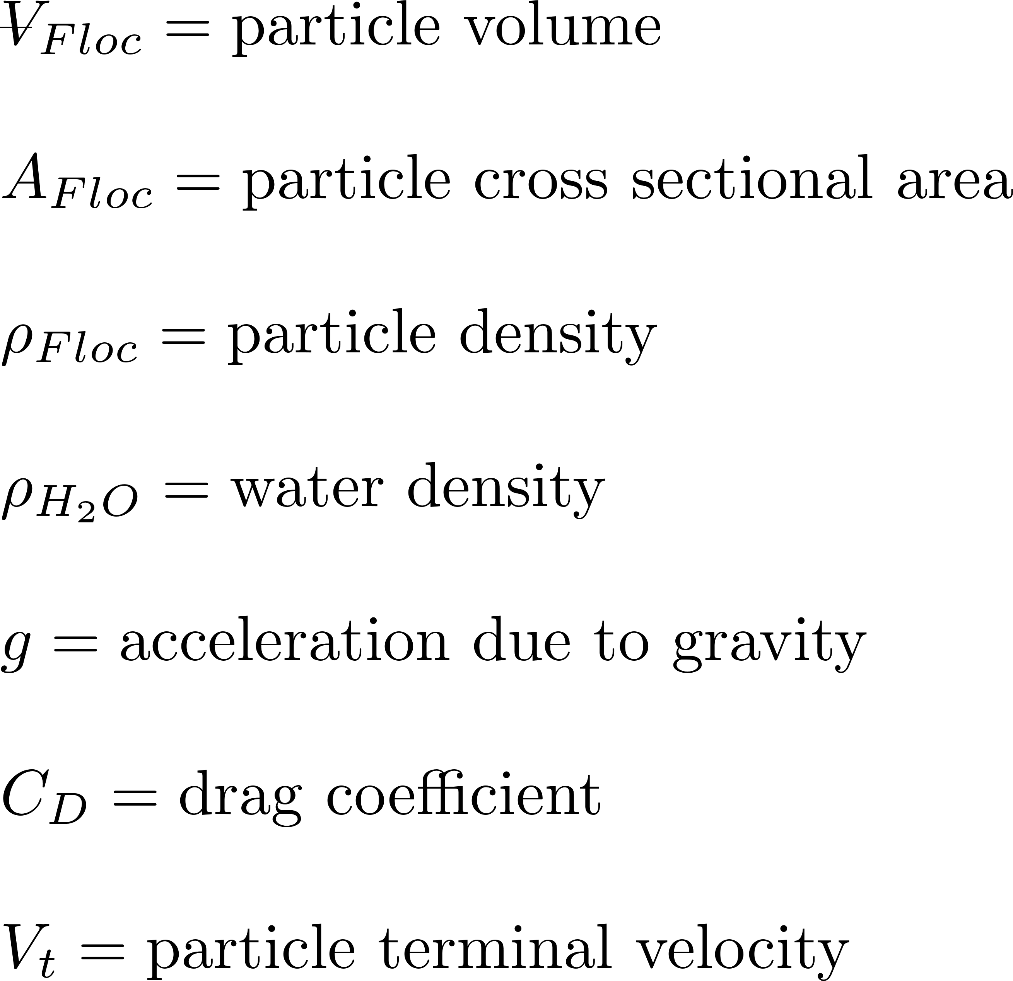
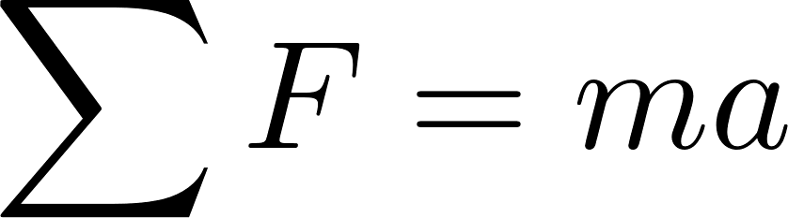





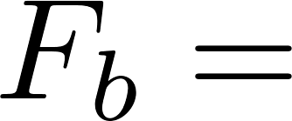
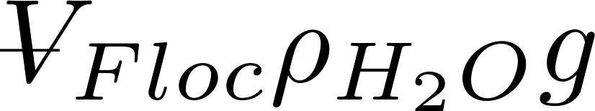
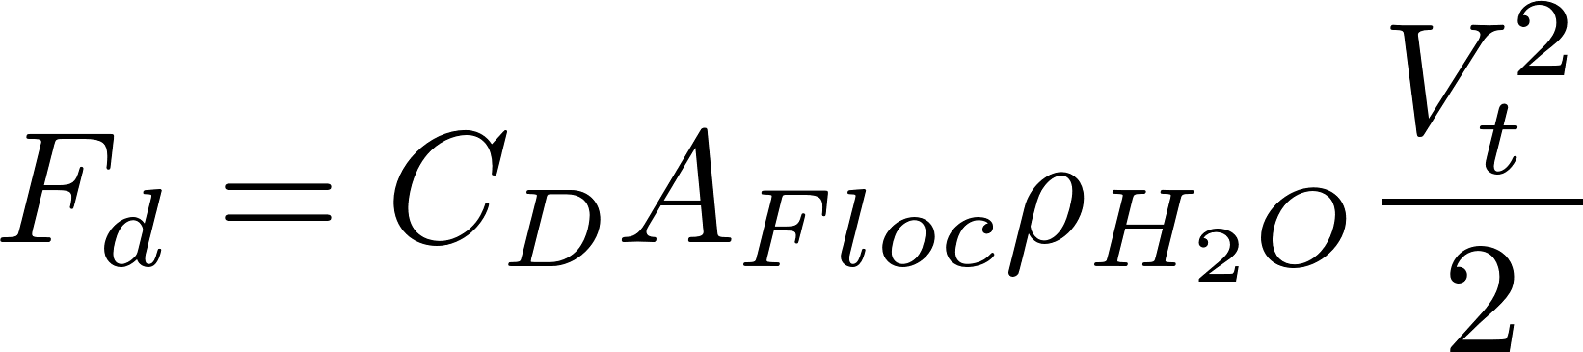

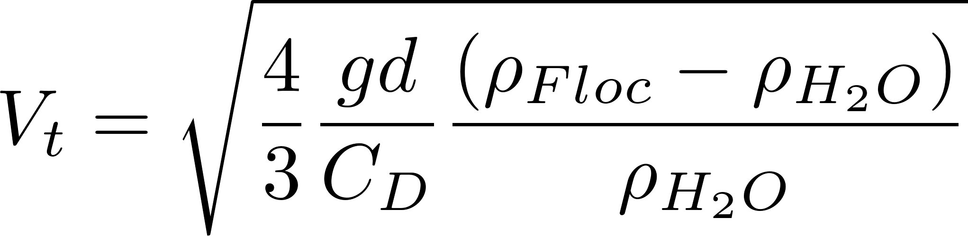
Sedimentation: Particle Terminal Fall Velocity
projected
Identify forces

Slide 6
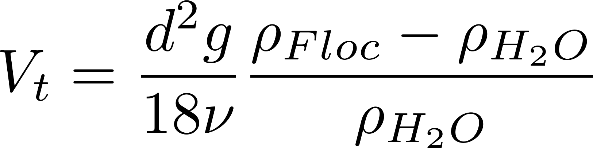
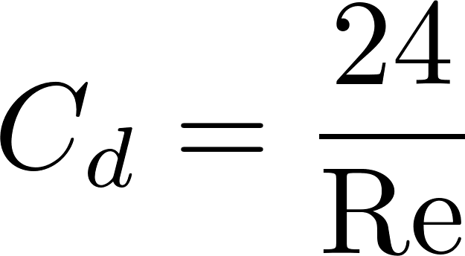
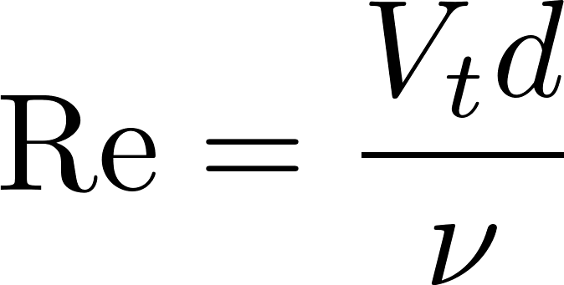
Drag Coefficient on a Sphere
Stokes Law
turbulent boundary
laminar
turbulent

Slide 7
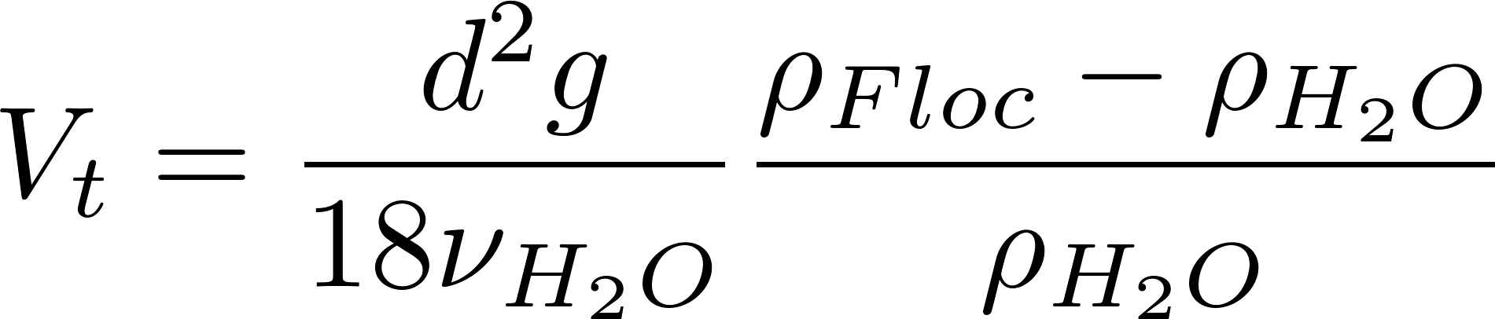
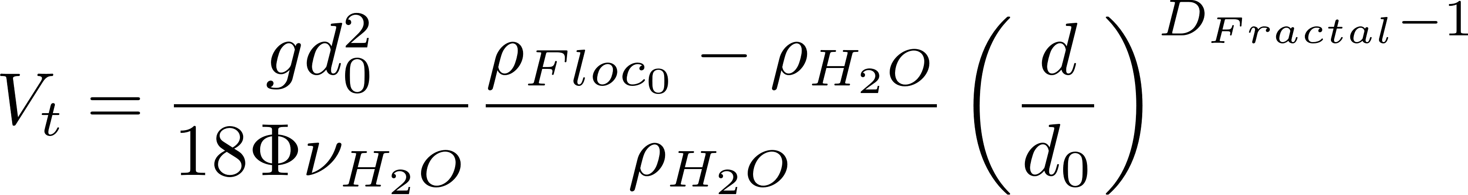
Floc Terminal Velocity
floc blanket velocity
Capture velocity for AguaClara plate settlers
Why flocculation is necessary!
D_{Fractal} = 2.3 and d₀ = 4 μm
The model takes into account the changing density of flocs

Slide 8
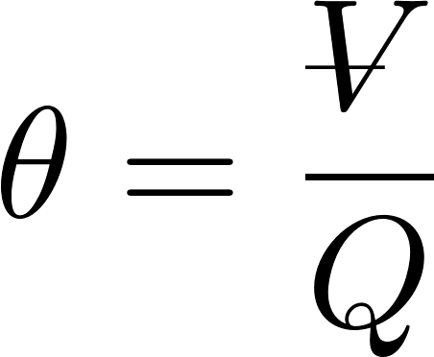
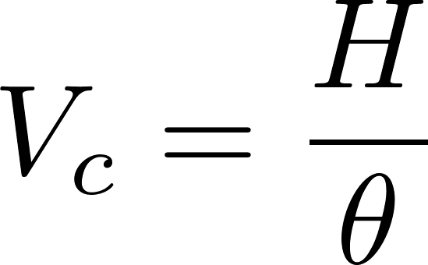
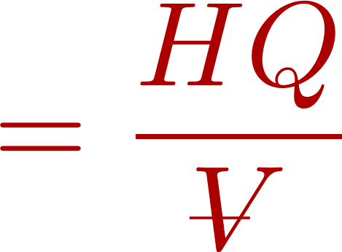
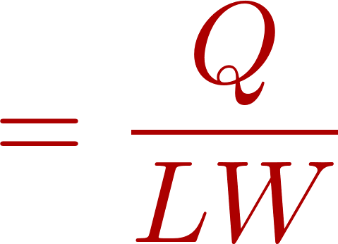
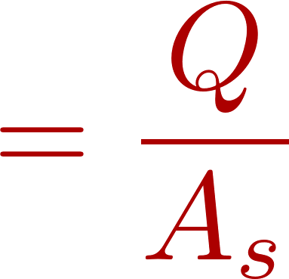
Horizontal Flow Sedimentation Tank
How much time is required for water to pass through the tank? _____
How far must a particle fall to reach the bottom of the tank (worst case)? _____
How fast must the particle fall?
W
θ
H
H
L
entrance
exit
Yes
Will it remove any smaller particles? ___
Settle Capture velocity: Property of the sedimentation tank. The slowest settling particle that the sedimentation tank captures reliably.
Notes:
How do I design a sed tank to capture 40 um flocs?

Slide 9
Vertical Flow Sedimentation Tank
How much time is required for water to pass through the tank? _____
How far must a particle fall relative to the fluid to not be carried out the exit? _____
How fast must the particle fall (relative to the fluid)?
exit
θ
W
L
H
H
Will any smaller colloids be captured? ______________________________ ______________________________
Only if they collide and grow so they have a sed velocity > V_{c}
entrance

Slide 10
Settle Capture Velocity Guidelines
Based on tube settlers
0.12 – 0.36 mm/s
Based on Horizontal flow tanks
0.24 to 0.72 mm/s
AguaClara adopted 0.12 mm/s in an effort to reduce effluent turbidity as much as possible because AguaClara wasn’t using filters
We’d like to know the performance curve. How does settled water turbidity change with the capture velocity? More research is needed!
Save plastic by increasing the capture velocity
http://www.brentwoodprocess.com/tubesystems_main.html
Surface Water Treatment for Communities in Developing Countries. Christopher R. Schulz,Daniel A. Okun

Slide 11
Vertical Flow Sedimentation Tanks
Have lower velocities and hence turbulence levels might be lower (plan view area is larger than width x height
Require careful attention to delivery and extraction of water
AguaClara uses channels at one end of the tanks that are connected to pipes to deliver and extract water – other geometries would be possible

Slide 12
Stagnant Water (or Ripe for Innovation?)
extra
State of the art in sedimentation…
Empirical guidelines
No understanding of scaling effects
Last significant paper on tube settlers was published in 1978
No significant revisions to Ten State Standards section on sedimentation in the past 30 years
Notes:
Personal communication with Daryl Bond and Frank Kulick of Brentwood Industries
9 records in Compendex for 1884-2010 Save Search - Create Alert -
((((tube settler) WN ALL)) AND ({water treatment} WN CV))
TUBULAR SETTLERS - A TECHNICAL REVIEW. Willis, Roderick M. Source: Journal / American Water Works Association, v 70, n 6, p 331-335, Jun 1978

Slide 13




AguaClara Sedimentation Tank
Dump poorly flocculated water channel
Exit Weir that controls water levels all the way upstream to the next free fall (LFOM!)
Notes:
Exercise: Tell the story of the journey of a large floc, a small floc, a rouge loner clay particle, and of a water molecule as each travels through this sedimentation tank.
How do plate settlers work

Slide 14
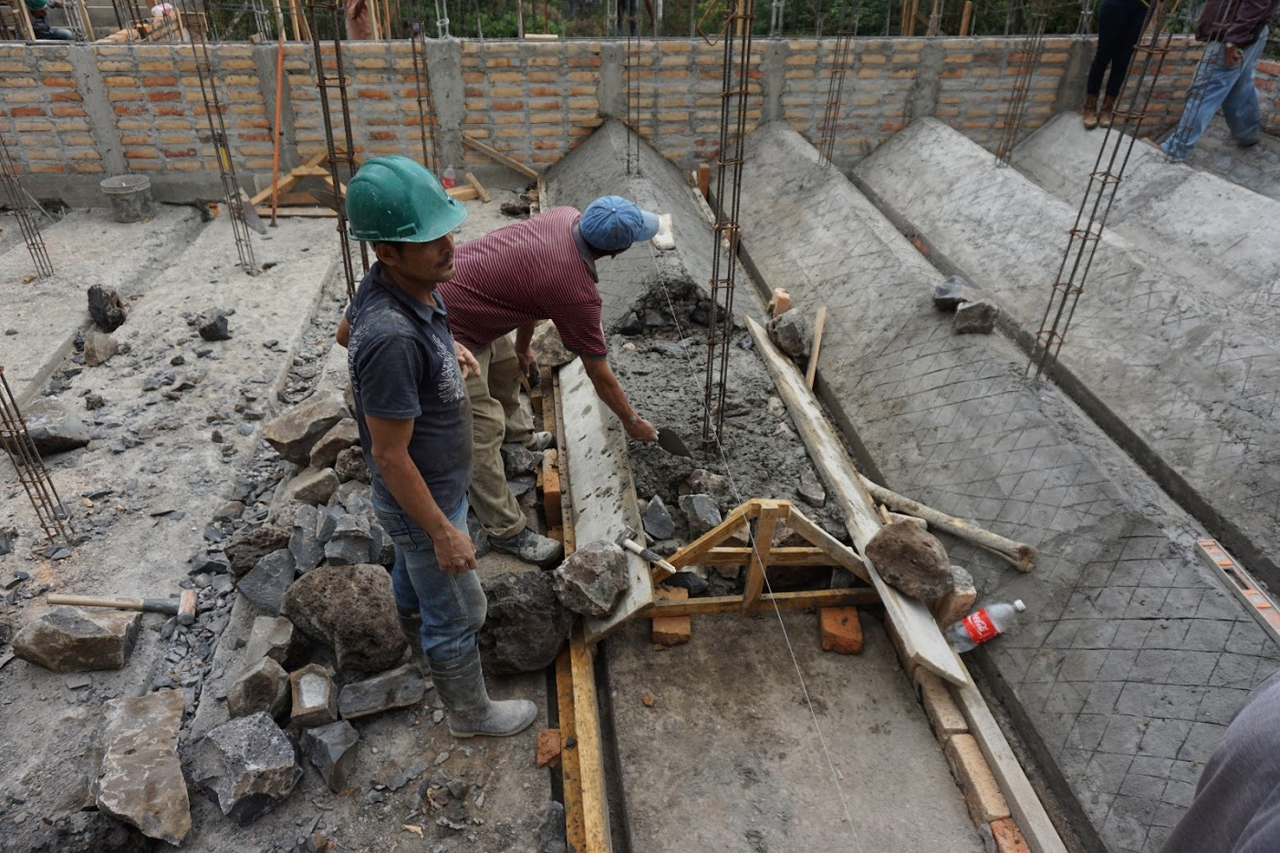

Slide 15
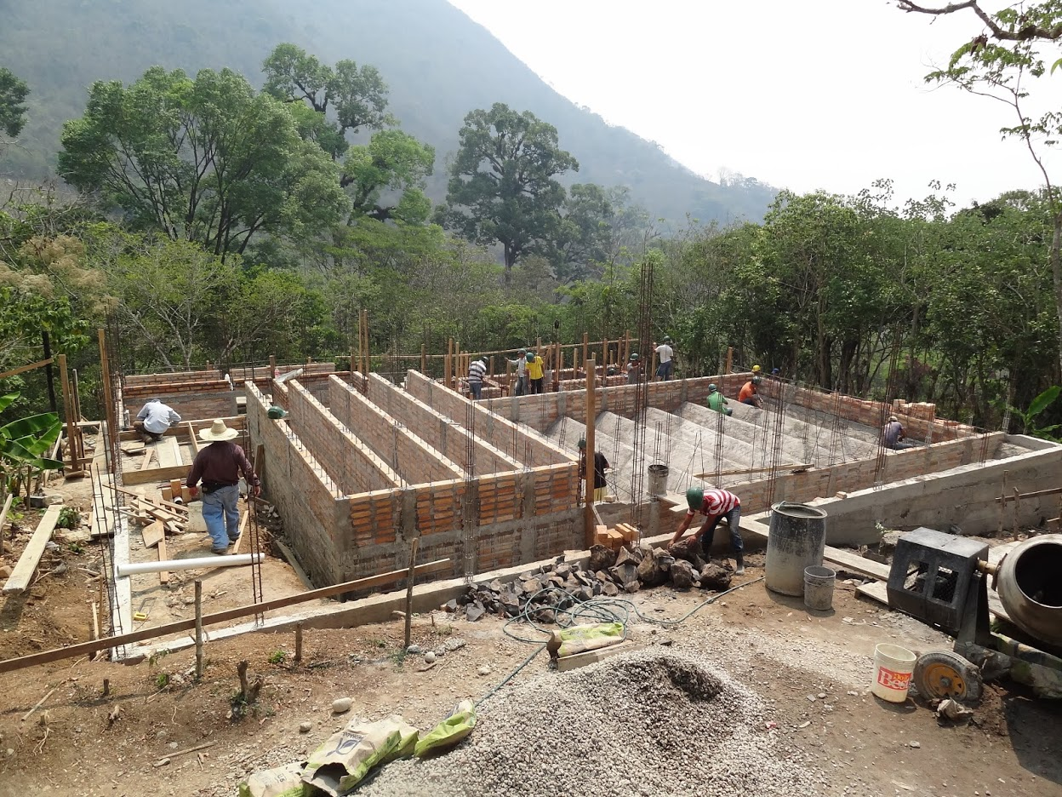

Slide 16
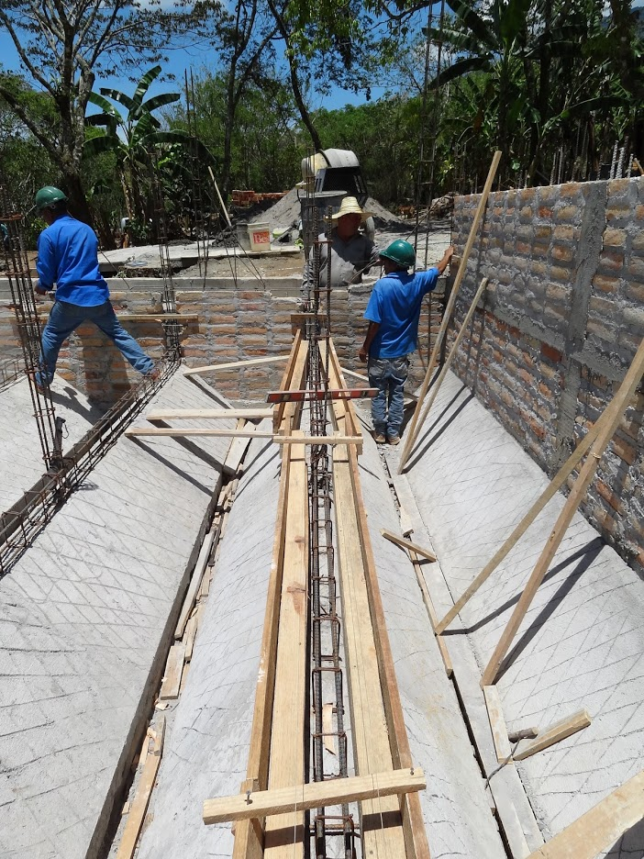

Slide 17
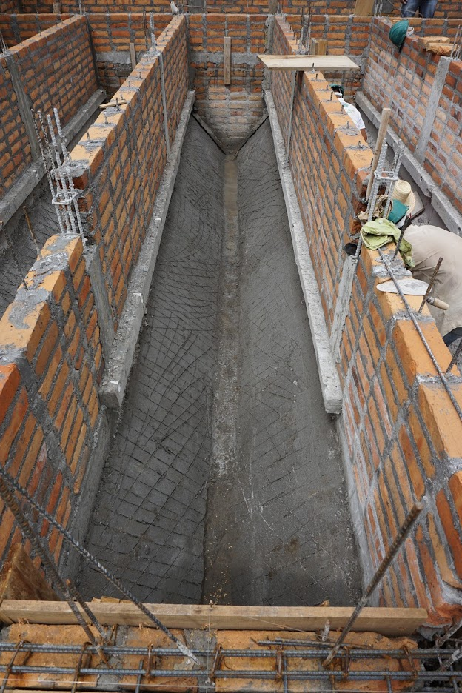
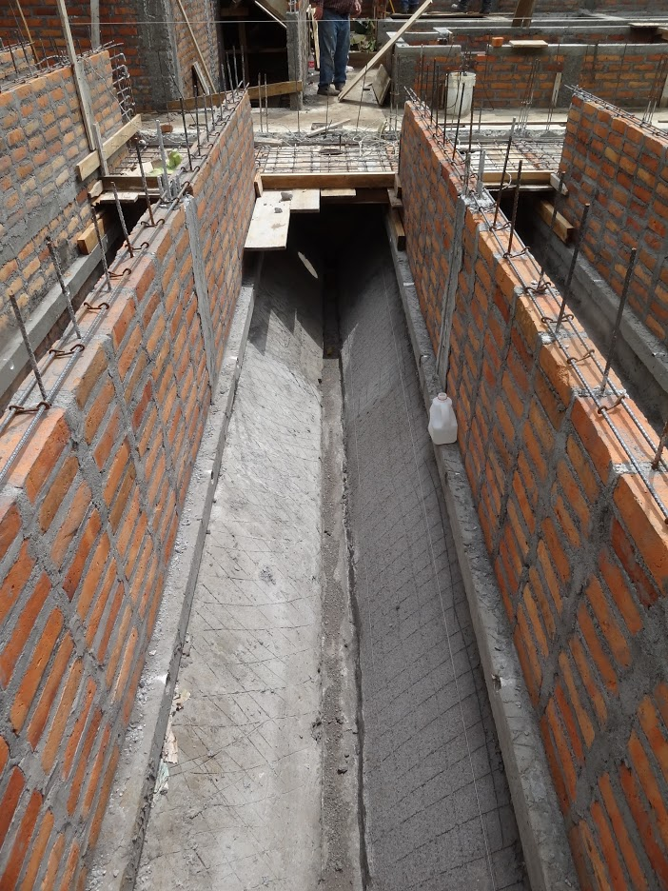

Slide 18
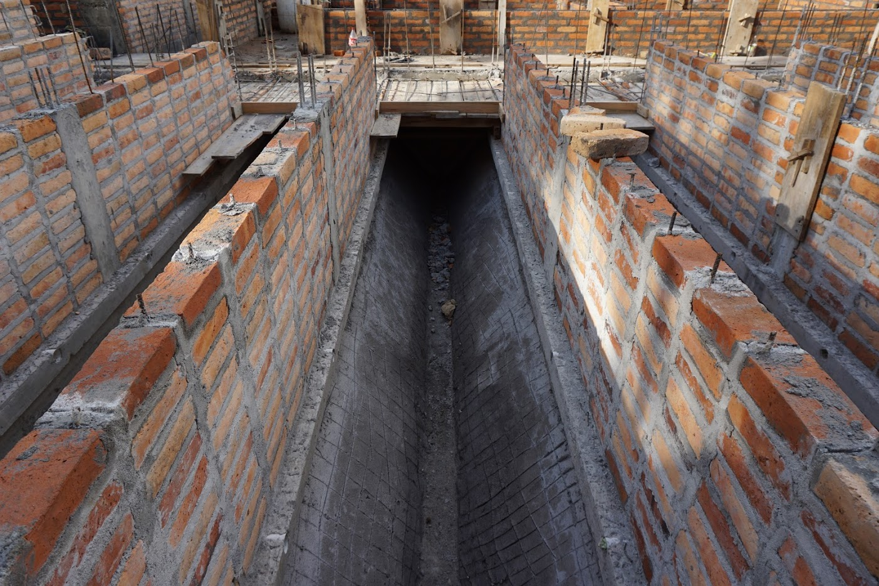

Slide 19
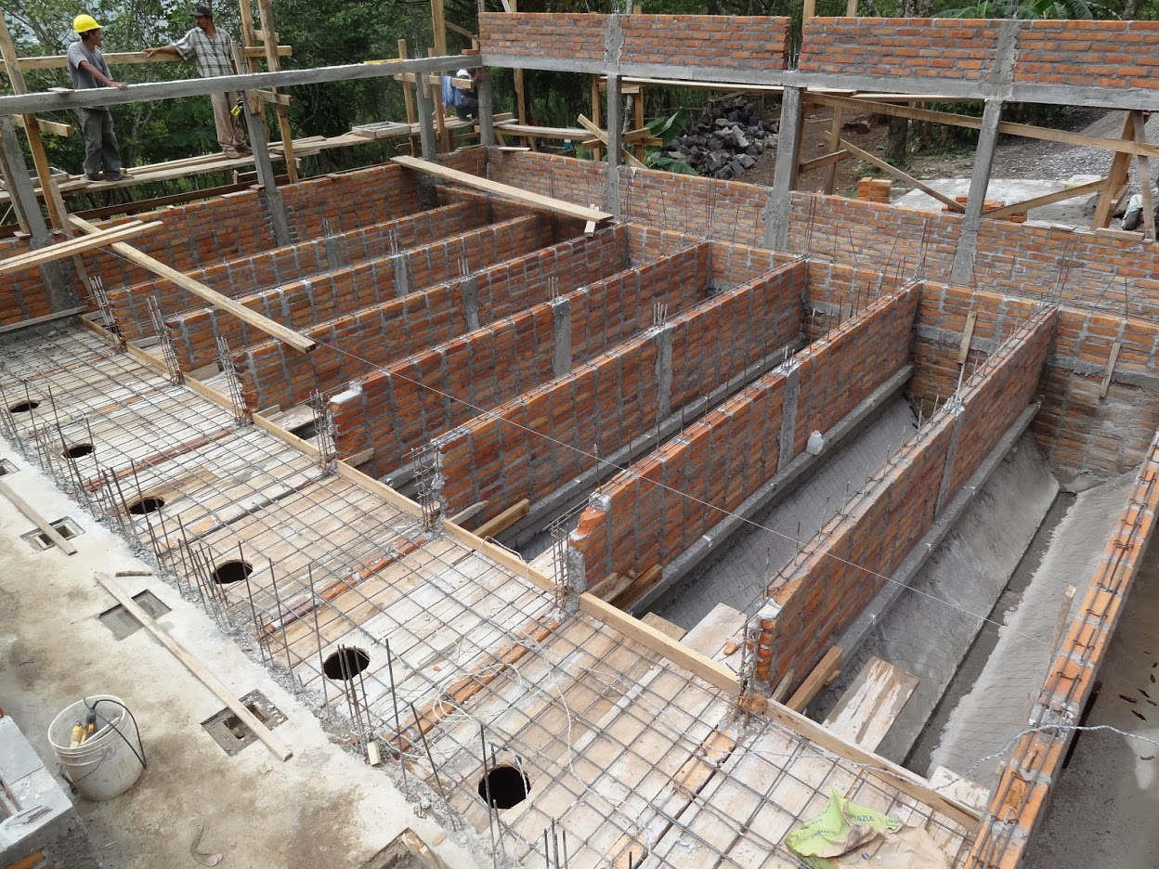

Slide 20
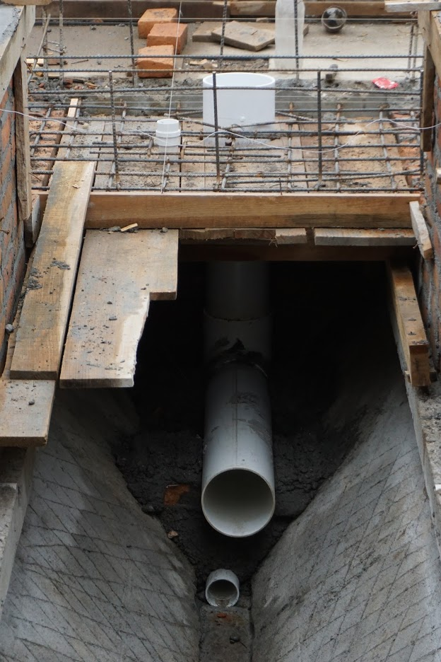
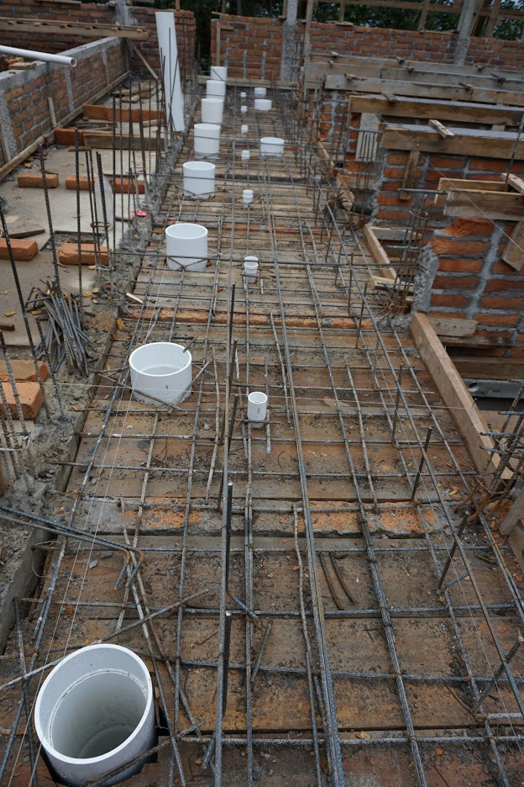

Slide 21
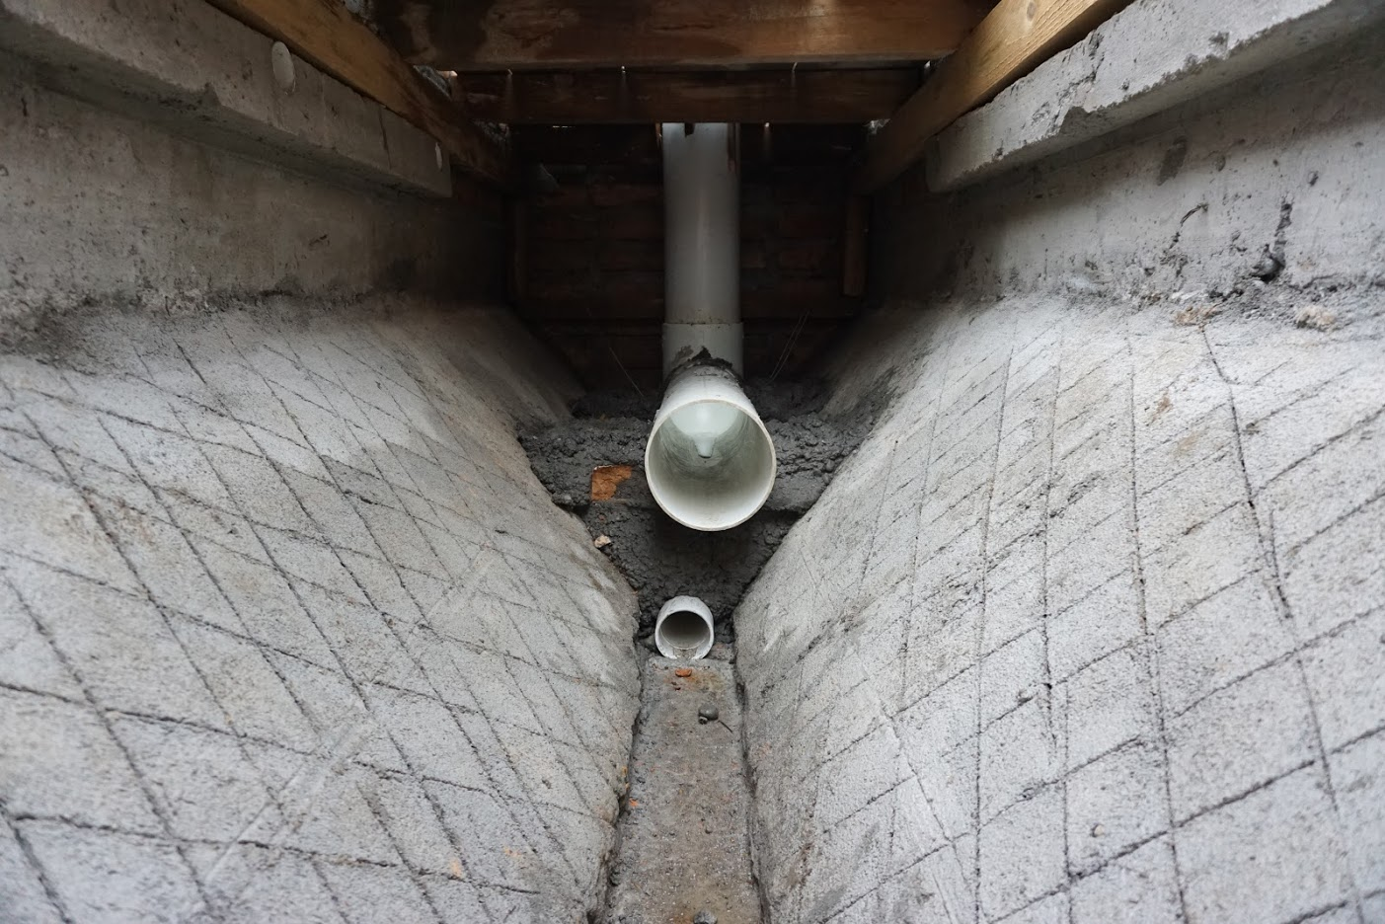

Slide 22
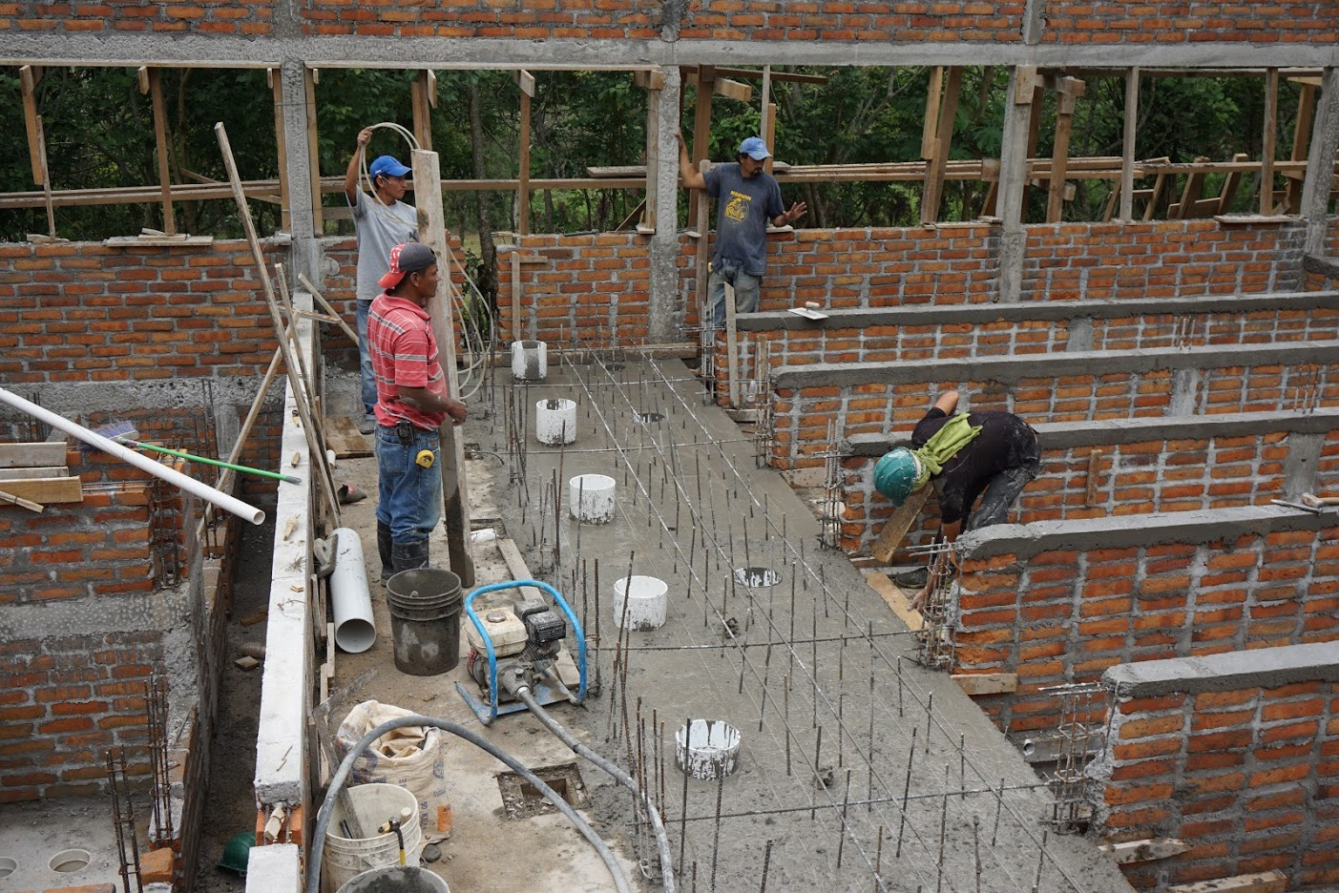

Slide 23
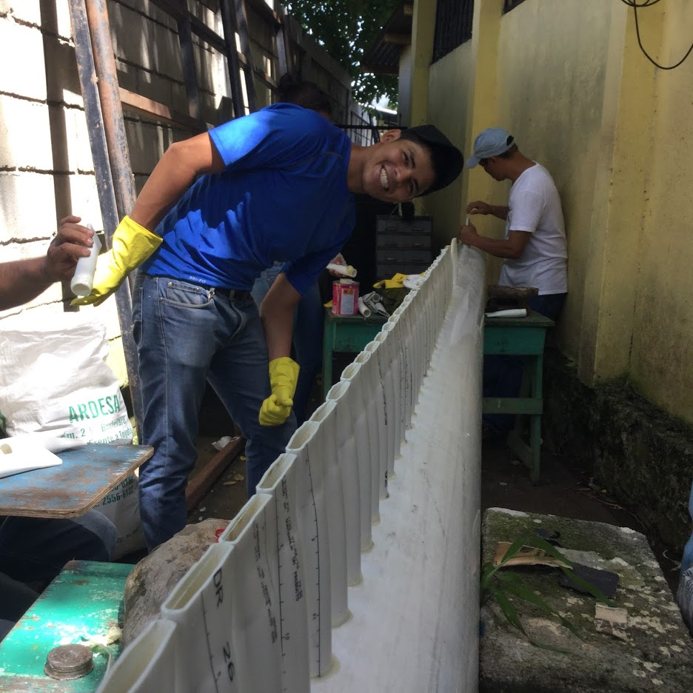

Slide 24
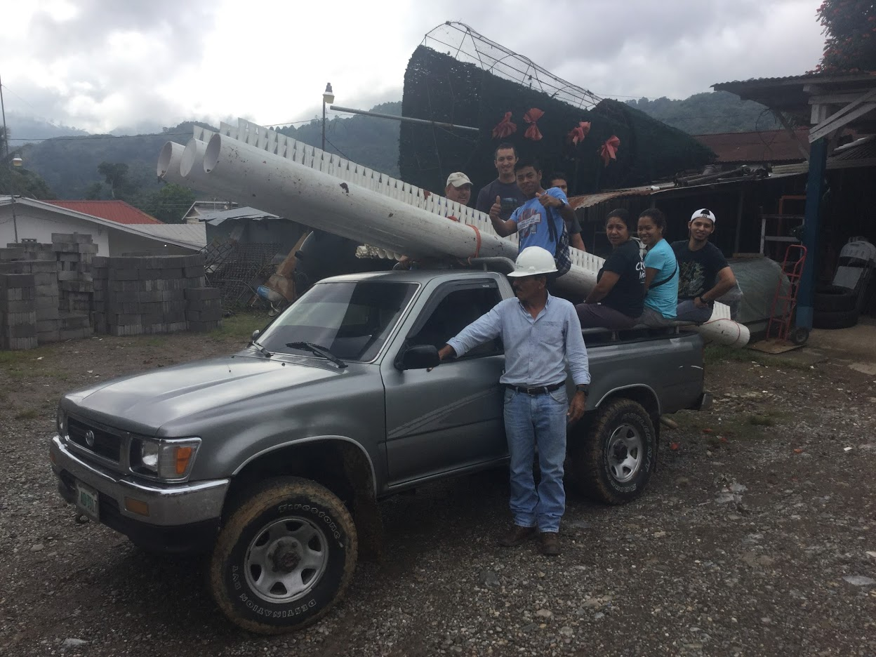

Slide 25
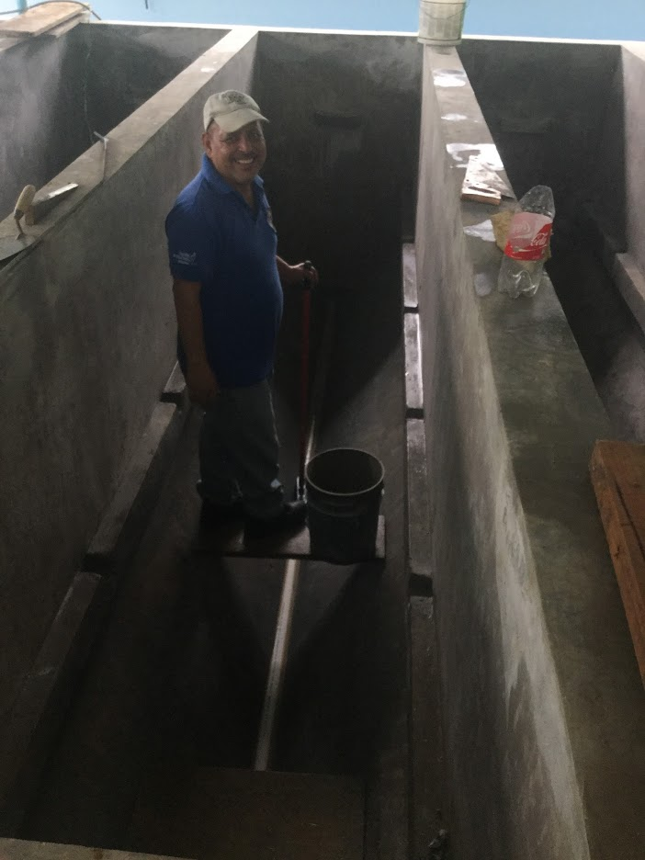
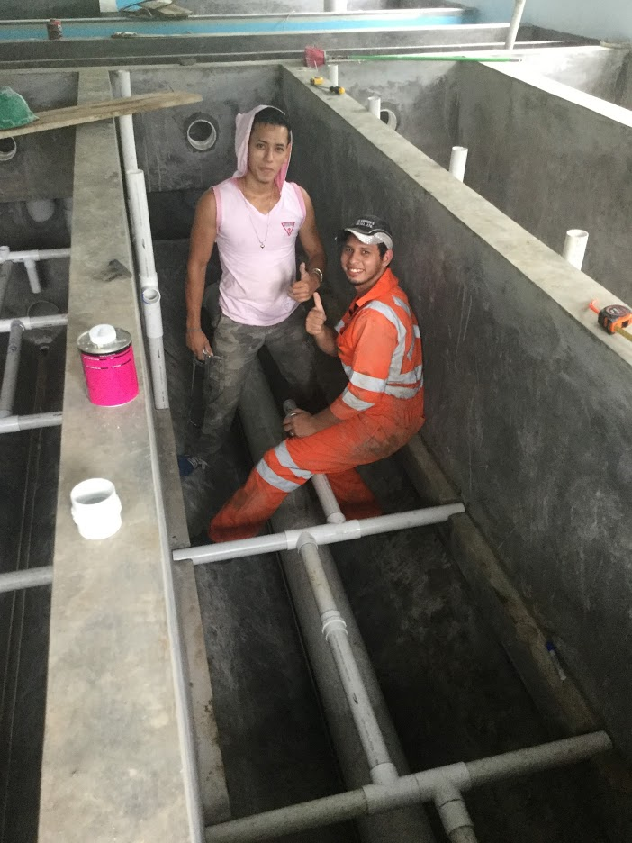

Slide 26
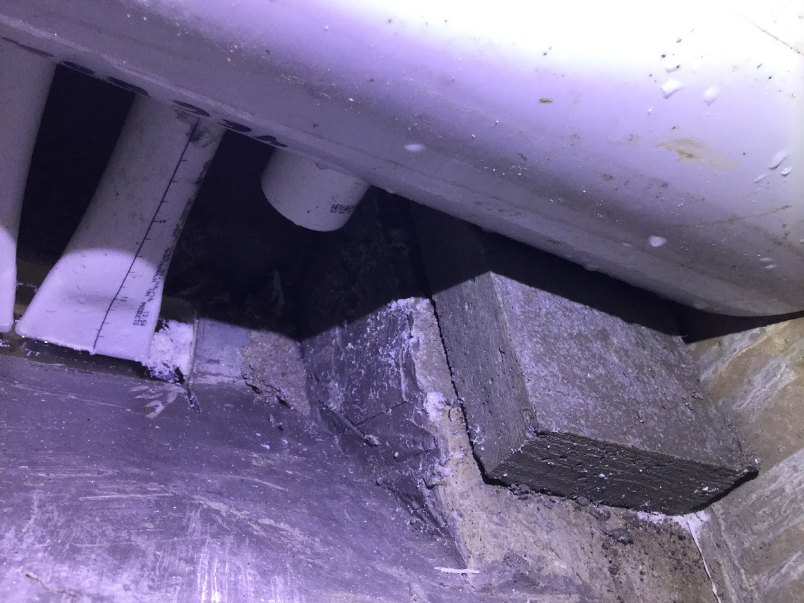

Slide 27
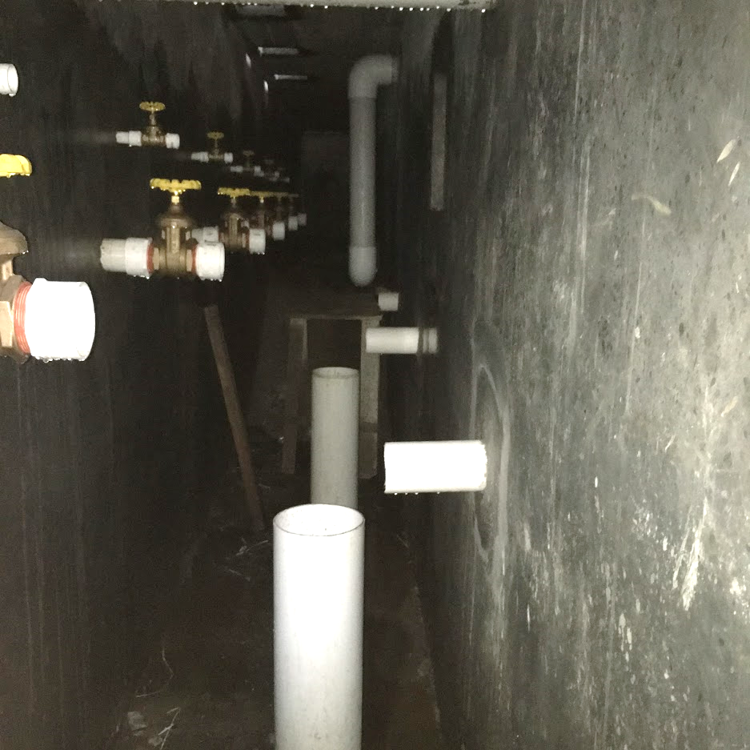

Slide 28
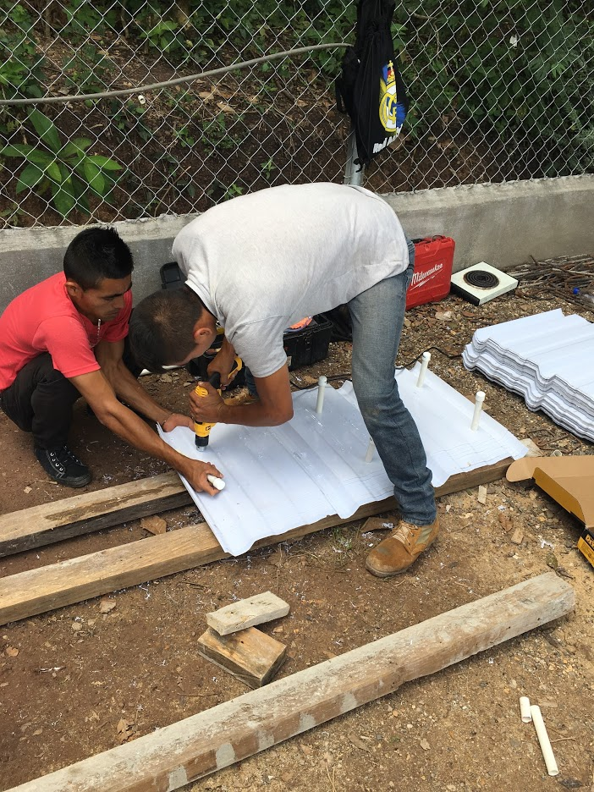
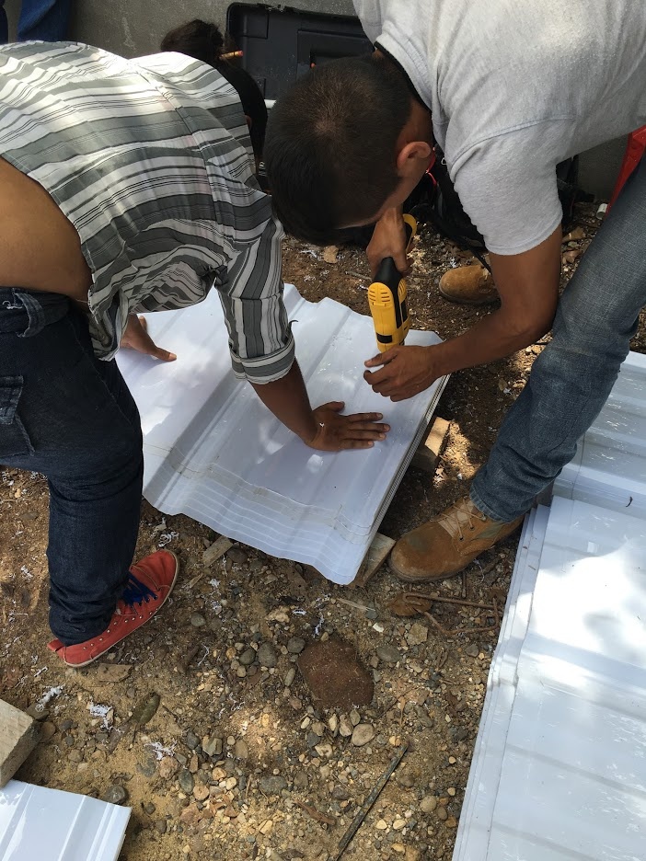

Slide 29
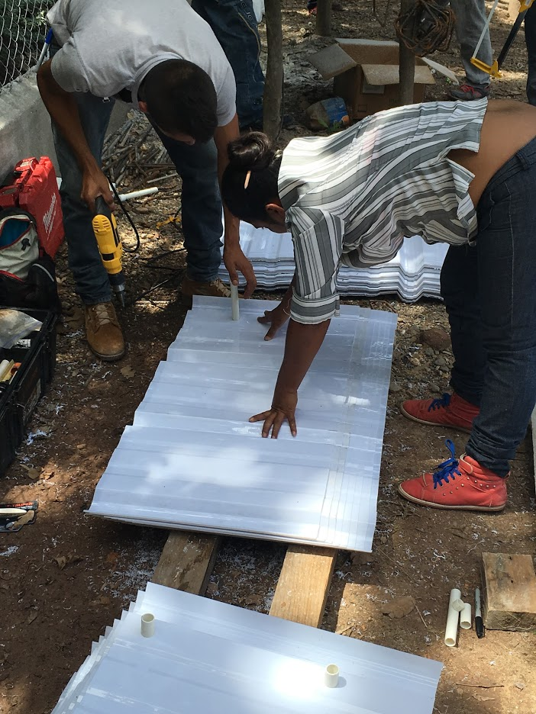
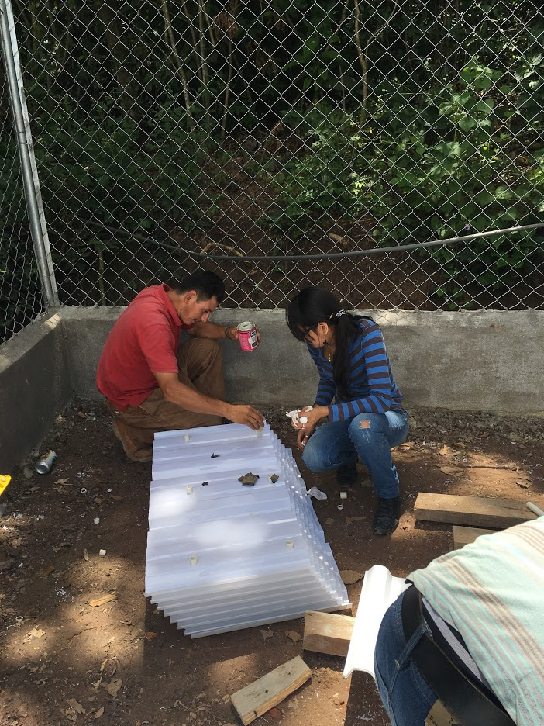

Slide 30
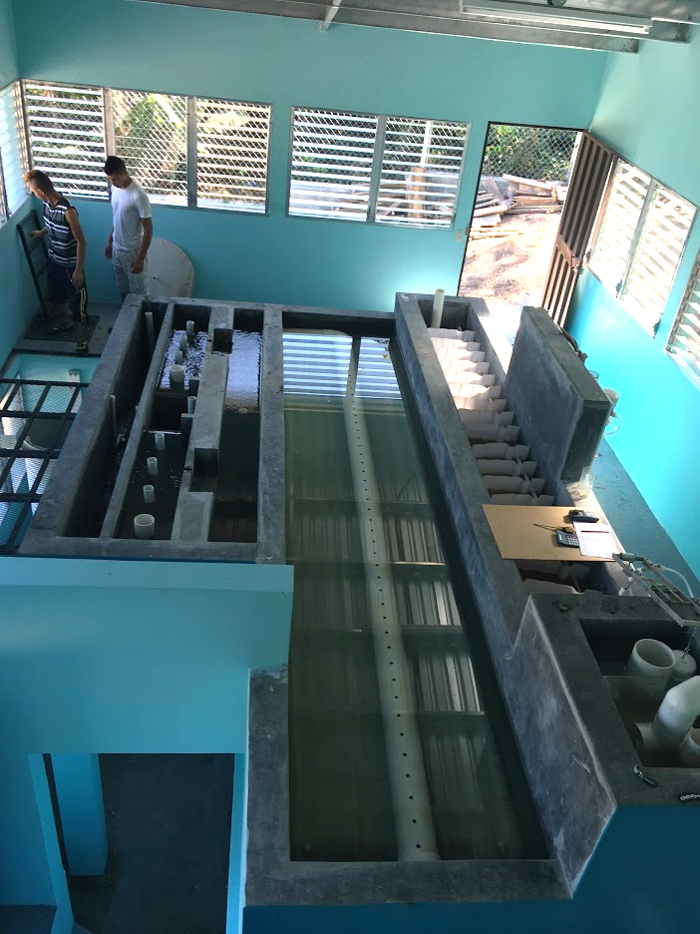
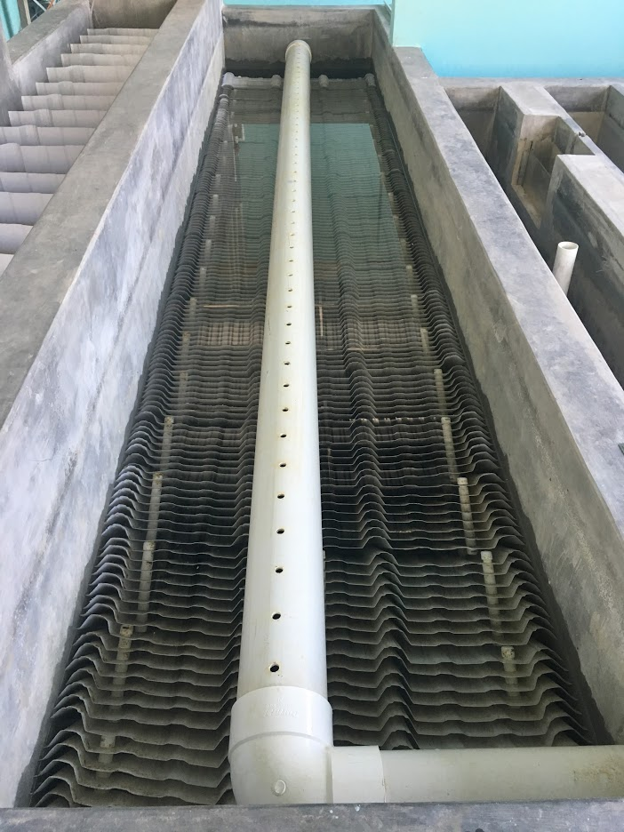

Slide 31

AguaClara Sed Tank Geometry

Slide 32

AguaClara Sed Tank Geometry

Slide 33
Sedimentation Tank Geometry: plate settlers have a lost triangle
V_{Plate↑} > V_{Active↑} > V_{Sed↑}
V_{Plate↑} · S = V_{Active↑} · B
L_{SedActive}
W_{Sed} · L_{SedActive} · V_{Active↑} = Q_{Sed}
W_{Sed} · L_{SedFloc} · V_{Sed↑} = Q_{Sed}
Notes:
Give the two reasons why water accelerates when it enters the plate settlers.
It has less cross sectional area due to the space occupied by the plate settler material
It must maintained the same vertical flow velocity and it must also add a horizontal component due to the slope of the plates.

Slide 34
3 Steps to Sedimentation Success
The floc must be able to settle unto the surface of a plate or tube settler
Settle capture velocity
It must slide down the incline to reach the lower section of the sedimentation tank
Slide capture velocity
Finally the floc must be removed from the lower section of the sedimentation tank
Floc hopper

Slide 35






Settle Capture Velocity for Plate (and Tube) Settlers
Path for critical particle?
How far must particle settle to reach lower plate?
h_{c}
L
h
S
What is total vertical distance that particle will travel?
α
α
V_{Plate↑}
V_{α}
What is net vertical velocity?
Resultant particle velocity

Slide 36






Compare Times
Time to travel distance h_{c}
=
Time to travel distance h
5 parameters… how do we choose?
Notes:
The ratio of the upflow velocity to the capture velocity is really a measure of the reduction in tank area that is possible from using plate settlers. It is easy to get a factor of 10 reduction.

Slide 37






Comparison with Q/A_{s}
extra
A_{s} is horizontal area over which particles can settle
h_{c}
L
h
S
α
α
V_{Plate↑}
V_{α}
Same answer!

Slide 38





Equation for capture velocity

Slide 39



Performance ratio (conventional to plate/tube settlers)
extra
Compare the area on which a particle can be removed
Use a single plate settler to simplify the comparison
L
S
Plate/tube capture area
Conventional capture area
α

Slide 40




Settle Capture Velocity Confusion
extra
Surface Water Treatment for Communities in Developing Countries, Schulz and Okun (1984)
Consistent, but no one uses this geometry except in labs
Water Quality and Treatment (1999)
inconsistent
Weber-Shirk
Assume that the geometry is

Slide 41
Thick Plate Settlers
extra
S Distance between plate settlers
B Center to center distance
T Plate settler thickness
Vertical velocity component beneath the plate settlers
Vertical velocity component between the plate settlers
h_{c}
L
h
S
α
V_{Active↑}
α
V_{Plate↑}
V_{α}
V_{Plate↑}
V_{Active↑}

Slide 42







Thick Plate Settlers
extra
Mass Conservation
Geometry

Slide 43




Plate Settler Design (AguaClara approach)
V_{Sed↑}
Upflow velocity (determines size of tanks) (1 mm/s)
If floc blanket is a goal then needs to be approximately 1 mm/s*
Capture velocity (0.12 mm/s)
target turbidity
particle size distribution after floc blanket
Plate angle (60 deg)
self cleaning (60 deg works well)
Spacing (2.5 cm)
Clogging (not a problem at 2.5 cm)
floc roll up: Will the floc slide down? (next topic in the notes!)
Length of the plate settlers
will be the parameter that we calculate
Needs research!
* Active research topic!
2011 AguaClara design

Slide 44
Plate Settler Spacing Constraints: Floc Rollup
Why do we care? – What is the connection to sustainability?
Why not use the standard design?

Slide 45



Floc Roll Up Solution Scheme: Another failure mode
Find the velocity gradient next to the plate
Find the fluid velocity at the center of the floc
Find the terminal velocity of the floc down the plate (for the case of zero velocity fluid)
Set those two velocities equal for the critical case of no movement
Find the floc sedimentation velocity that can be captured given a plate spacing (V_{Slide})
v_{α}
α
gsin(α)
g
α
α

Slide 46








Infinite Horizontal Plates: Boundary Conditions
extra
y
No slip condition
u = 0 at y = 0 and y = S
S
τ
u
x
let
negative
be___________
What can we learn about τ?

Slide 47











Navier Stokes Flow between Plates
extra
Integrate to get average velocity
V_{α} is average velocity between plates
We have velocity gradient as a function of average velocity
Notes:
q is flow per unit width
u is fluid velocity as a function of location
S is spacing between the plates

Slide 48





Laminar Flow through Circular Tubes: Equations no gravity
extra
R is radius of the tube
Max velocity when r = 0
Velocity distribution is paraboloid of revolution therefore _____________ _____________
average velocity (V) is 1/2 v_{max}

Slide 49






Velocity gradient at the wall
extra
Where dp/dx is the pressure gradient in the direction of flow NOT due to changes in elevation
Tube geometry
Plate geometry
Average velocity

Slide 50








Floc Rollup Constraint
extra
Velocity at center of floc
floc diameter
v_{α}
α
Linearized (plates)
gsin(α)
g
α
Failure point (floc stationary)
Terminal velocity
α
Notes:
d is floc diameter
What happens when floc slides down to high shear zone?

Slide 51


Spacing as a function of floc terminal velocity
extra
But terminal velocity and floc diameter are related!
Sedimentation velocity solved for diameter
This is the smallest spacing that will allow a floc with a given settling velocity to remain stationary on the slope (and not be carried upward)

Slide 52

Minimum Plate Settler Spacing (function of Floc V_{t})
Fewer, but longer plate settlers due to higher upflow velocity in the sed tank
Current AguaClara design for
Which flocs (big or little) are more like to slide up?
What happens if a floc forms from organic matter rather than clay?
Plate settler spacing of 5 mm or larger should be adequate if the capture velocity is 0.12 mm/s
Notes:
If we use a spacing that is smaller than this plot, then particles that reliably make it to the plate end up not being removed because the are rolled out the top! This is the minimum spacing that will not cause a reduction in performance.
Note that as Vt goes up, that S decreases. This means that larger flocs slide down more easily.
This is the minimum spacing to be able to capture particle with a sedimentation velocity of Vt. At smaller spacings flocs with a sedimentation velocity of Vt will roll up.
Is there a clearer way to plot this or some non dimensional way to show these results to make design easier?
How will this information be used in a design process?
First given the Vupplate and the target capture velocity we can find a minumum S.
Then given an actual design S we can use the capture velocity equation to get a plate length.
Or… It doesn’t work to use the ratio of Vt/VupPlate because Vt is also in the other term in the equation.

Slide 53


Slide Capture Velocity
extra
$V_{Slide}$ is the terminal sedimentation velocity (V_{t}) of the slowest-settling floc that can slide down an incline. Flocs with this terminal velocity (the slide velocity) will be held stationary on the incline because of a balance between gravitational forces and fluid drag. Flocs with a terminal velocity lower than $V_{Slide}$ will be carried out the top of the tube (i.e., “roll up”) even if they settle onto the tube wall. Thus, the slide terminal velocity represents a constraint on the ability of plate settlers to capture flocs.
$V_{Slide}$ ↑
What happens if the primary particles are less dense? _____

Slide 54

Experimental Evidence that the Slide Capture Velocity Matters
extra
If V_{Slide} is bigger than V_{Settle}, then some flocs that we expected to capture will slide out the top
All experiments were performed at the same settle capture velocity
Floc Roll-up and its Implications for the Spacing of Inclined Settlers Matthew W. Hurst, Michael J. Adelman, Monroe L. Weber-Shirk, Tanya S. Cabrito, Cosme Somogyi, and Leonard W. Lion. Journal of Environmental Engineering, submitted (2012)
Notes:
Floc Roll-up and its Implications for the Spacing of Inclined Settlers Matthew W. Hurst, Michael J. Adelman, Monroe L. Weber-Shirk, \\Tanya S. Cabrito, Cosme Somogyi, and Leonard W. Lion. Journal of Environmental Engineering, submitted (2012)

Slide 55



Plate Settler Spacing effects
Plate settler spacing has a strong influence on sedimentation tank depth
Diminishing effect for small S
Reduced spacing results in increased pressure drop through plate settlers*
Which plate settlers will have more uniform flow distribution? ___________
5 cm spacing = 2.27 m deep
2.5 cm spacing = 1.84 m deep
1 cm spacing = 1.64 m deep
Small S
*proof coming up…
Notes:
6 L/s plant with 2 sed tanks.
I think that going to 1 cm spacing has promise for cutting plant costs. It would allow us to use deeper floc blankets. I wonder if we can devise a fabrication method that includes flow resistance on each plate.

Slide 56






Pressure drop (from head loss) through plate settlers
Velocity
Shear (wall on fluid)
Force balance
Viscous shear
Change L to maintain capture velocity
Notes:
The shear is acting on both plates. The pressure drop is due to the shear on the plates. The areas over which the shear and pressure act are different. As the space between the plates decreases the area over which the pressure is acting decreases too. Thus the pressure increases for two reasons. Area decreases and shear increases.

Slide 57

Plate Settler Head Loss
This represents an opportunity to improve design!
Head loss is tiny! We need some head loss to get reasonable flow distribution between (and within) plates. This lack of head loss may be one of the reasons for poor performance of full scale plate settlers. The velocity of any turbulent eddies or mean flow needs to be less than ______ to achieve uniform flow through plate settlers. The floc blanket will end up helping us here!
4 mm/s
Notes:
This sets the maximum velocity in the space above the plates settlers.
The lack of significant head loss through plate settlers means that any turbulence or mean velocities in the bottom of the sed tank will propagate through the plate settlers and result in non uniform distribution of flow between plates. In order to obtain reasonable uniform flow we need the velocities below the plate settlers to be close to 1 mm/s even if we use closely spaced plates. This is a daunting challenge given that the upflow velocity is 1 mm/s and given that the velocity coming from the inlet manifold ports is on the order of 100 mm/s (and thus turbulent eddies with velocities that are order 10 mm/s). The distance between the manifold ports and the bottom of the plate settlers will result in significant energy dissipation. The fact that AguaClara sed tanks are shallower than conventional design means that we need to understand and perhaps take additional steps to minimize velocities at the inlets of the plate settlers.
The AguaClara team is working to reduce velocities in the bottom of the sed tank by improving the design of the inlet manifold. The team is also evaluating the performance of small diameter tube settlers to confirm that there aren’t any other unforeseen problems caused by reducing the separation between the plate settlers.

Slide 58
Plate Settler Conclusions…
Laminar flow
Parabolic velocity profile is established
Very low head loss (and thus flow distribution between plates is difficult to ensure)
Designed to capture flocs with sedimentation velocities greater than the settle capture velocity
Spacing determines the ability of the flocs to roll down the incline (slide capture velocity)

Slide 59
Plate Settler Confusions…
We need a basis for choosing a settle capture velocity based on overall plant performance*
Smaller spacings have diminishing returns in terms of sedimentation tank depth. So for now we are using 2.5 cm.
Flocs made from natural organic matter may be less dense, more prone to floc rollup, and require larger spacing between plate settlers
* Predictive performance model for hydraulic flocculator design with polyaluminum chloride and aluminum sulfate coagulants. Karen A. Swetland, Monroe l. Weber-Shirk, and Leonard W. Lion. Journal of Environmental Engineering, submitted (2012)

Slide 60
Floc Volcanoes
Intermittent floc volcanoes in the sedimentation tanks at San Nicolas
Flocs rise preferentially on one side of the sed tanks
Raw water turbidity = 4 NTU
PACl dose = 3.5 mg/L
Settled water turbidity varies between 0.5 and 4 NTU
Brainstorm! What is happening? Why does our plant do so poorly?
Notes:
What do you know?
What could cause what is observed?
Which of those causes is consistent with observations?

Slide 61

Settled Turbidity at San Nicolas
Raw water
Turbidity (NTU)
Settled water

Slide 62

Plate Settler Problems: Temperature Gradients
Warmer water is less dense
Warm water rises
Cold water drops
Performance drops
Need a solution!
Could we further reduce residence time in sed tank so that density gradients are less significant?

Slide 63

Floc blankets reduce settled water turbidity
Research required to determine optimal upflow velocity
Floc blanket formation requires
All flocs be returned to the bottom of the sedimentation tank (plate settlers)
All settled flocs must be resuspended by incoming water (jet reverser)
We don’t have a model for floc blanket performance

Slide 64



Floc Blanket Research

Slide 65

Flocculator
Plate Settlers
No filter….
Sedimentation Tank

Slide 66

Notes:
How does the floc blanket remove small particles?
Are plate settlers needed after a floc blanket?
What determines how fast the floc/water interface rises? 100mg/L*1mm/s = 3000 mg/L * x mm/s
Why might a floc blanket reduce settled water turbidity?
How is water entering the tank?
Where do the solids eventually go?
What mechanisms could result in particle aggregation in a floc blanket?
It’s a filter
It’s a flocculator
Wait, filters and flocculators are really quite similar. (particles colliding and attaching)
New question: which flocs are active and which flocs are inactive in the floc blanket?

Slide 67

Notes:
How does the floc blanket remove small particles?
Are plate settlers needed after a floc blanket?
What determines how fast the floc/water interface rises? 100mg/L*1mm/s = 3000 mg/L * x mm/s
Why might a floc blanket reduce settled water turbidity?
How is water entering the tank?
Where do the solids eventually go?
What mechanisms could result in particle aggregation in a floc blanket?
It’s a filter
It’s a flocculator
Wait, filters and flocculators are really quite similar. (particles colliding and attaching)
New question: which flocs are active and which flocs are inactive in the floc blanket?

Slide 68





Density of the floc blanket
Empirical equation
Neglecting PACl
Density of the floc blanket is approximately equal to the mass of clay and water divided by the volume
Water volume fraction

Slide 69










Flocculation in a floc blanket due to shear from suspended flocs
See filtration notes for derivation
Head loss in a fluidized bed
Density of fluidized bed
Porosity of floc blanket
$φ_{FB}$ is approximately = 1 and is a function of C_{Clay}

Slide 70
Fluidized flocs provide a collision potential of a few thousand
Low G: flocs grow larger
Assuming: 1 mm/s upflow velocity, 1000s residence time
How does a small Gθ cause a large reduction in turbidity?
Notes:
Clearly, adding this much Gtheta to the flocculator would not have helped so much. So there is something else going on here.
Perhaps it is because it is at a much lower G and thus there is an opportunity for all flocs to grow again.
Tapered flocculation?
The high concentration of flocs provides many opportunities for clay particles to collide with big flocs. But are those collisions successful? Unknown.

Slide 71


Sedimentation Tank Bottom Geometry determines if floc blanket builds
Floc Hopper
Upflow velocity is 1 mm/s
Flat bottom
Jet Reverser

Slide 72




Floc Blanket Resuspender
Centered jet
Offset jet
Flat bottom
Diffuser tubes flattened to achieve line source
Floc pickup location
Jet reverser

Slide 73
Floc Blanket Resuspender
Inlet diffuser
How does this animation violate the laws of physics?

Slide 74

The jet reverser creates a vertical jet that resuspends settled flocs
All surfaces must transport particles to a resuspension zone.
Sludge produces gas that suspends particles.
Sedimentation tanks should have zero sludge!
May have application in other fluidized bed reactors.
7.5 cm
Notes:
May have application in other fluidized bed reactors too! No patents – you can use this new technology

Slide 75
Floc Blanket Resuspension
All surfaces in the sed tank with a horizontal component must return settled flocs to a resuspension zone.
Floc resuspension geometry works by having a flocculated water jet with a high vertical velocity component that returns settled flocs to the floc blanket

Slide 76






The jet deflects more when it has less momentum
Current of settled flocs
Current of settled flocs
$$θ_{1}$$
$$θ_{2}$$
Jet
Jet
3.9 mm Jet Diameter
8.9 mm Jet Diameter
$$θ_{1}$$
<
$$θ_{2}$$

Slide 77
Floc Blanket Conclusions
Perhaps (low G) flocculation to provide rapid growth of the flocs coming from the flocculator
Reduces the turbidity after sedimentation
Requires a mechanism to keep the flocs suspended
Upflow velocity of approximately 1 mm/s
Settled flocs must return to a resuspension point where they are carried upward by a vertical jet

Slide 78
Floc Blanket Questions
How deep should it be? (need to understand how it works!)
How do you design for flow rate variability including turning off a sedimentation tank?
Can a settled floc blanket be resuspended? (yes, at least sometimes)
What is the optimal velocity of the incoming jet? (high velocity is better for resuspension and breaks more flocs)
How will the operator observe the floc blanket? (sensor is under development)

Slide 79
Floc Hopper Requirements
Control the depth of the floc blanket
Allow time for floc blanket overflow to concentrate (consolidate and dewater)
Floc blanket solids concentration decreases as coagulant dose increases (2 g/L is reasonable estimate)
Floc blanket flow into the floc hopper is a function of the mass flux of particles into the sed tank
We need to characterize the consolidation rate of the flocs to optimize the floc hopper design
Notes:
If influent concentration is 20 mg/L, and floc blanket is 2000 mg/L, then what is the flow rate into the floc hopper

Slide 80


Self-cleaning, sludge-free sedimentation tank (without using electricity)
Notes:
Note that red dye can be removed by Polyaluminum chloride!

Slide 81

Consolidation Questions
AguaClara built our first successful floc hoppers at Atima in Honduras. We have much to learn about this design. (and they work!!!!)
Floc consolidation in the floc hopper results in less water waste from the sedimentation tank.
Zero sludge sed tank design reduces need to clean sedimentation tank
We don’t yet have a method to guide the operation of the floc hopper. How will the operator know if the floc hopper valve should be opened further?

Slide 82

Lab scale floc blanket, tube settler, floc hopper

Slide 83


Delivering Flocs to the Sedimentation Tank
It is necessary to design the inlet channel, inlet manifold, and diffusers so that they
Don’t drop the flocs (0.15 m/s)
Distribute the water uniformly (section on manifold hydraulics)
Create a jet that resuspends settled flocs
Min V
Max V
Min V
Notes:
The “don’t break the flocs” was considered the most important constraint prior to 2014. The new constraint is flow distribution.

Slide 84

Flow distribution
Pipe stubs to block sed tank inlet manifolds
Inlet channel
Flocculated water to waste
Sensor access to floc hopper
Settled water outlet channel
Weir that controls water level in sed tank (and flocculator)
Settled water outlet channel
Which sed tank will have the highest flow?
Notes:
#6 will have the highest flow rate if inlet channel has a constant cross sectional area.

Slide 85

Sedimentation tank controls
Drain for flocculated water
Weir that maintains the water level in the flocculator when flocculating to waste
Wall between inlet and outlet channels
Exit weir that maintains the water level in the sedimentation tank (and flocculator)
Exit to the filters
Entrance from the flocculator

Slide 86





Sed Tank as a Circuit: Flow Distribution Challenge
Piezometric head change from flow acceleration and head loss
Battery creates 5 to 10 cm of potential energy to drive the flow
Launder exit losses
Settled water outlet channel
Launder orifice loss
Floc blanket and plate settlers
Inlet channel
Diffuser exit loss
Inlet manifold
Effluent manifold (Launder)
Piezometric head change from
Flow deceleration and head loss
Flow distribution is a major hydraulic design constraint (see manifolds.pptx)
Notes:
We will cover this in manifold hydraulics if we have time. Which resistance is good and improves flow distribution? Which resistance makes flow distribution poor?
Improve by increasing losses in diffusers and in orifices

Slide 87



Design of the Inlet Diffuser
If a sedimentation tank has a length of 6 m, a width of 1 m, a depth of 2 m, an upflow velocity of 1 mm/s, and a diffuser spacing ($B_{Diffuser}$) of 5 cm…
What is the port flow rate? ________________________
(50 mm)(1 m)(1 mm/s) = 50 mL/s

Slide 88












Diffuser Slot Width
$$B_{Diffuser}$$
$$W_{Diffuser}$$
$$S_{Diffuser}$$
Proposed constraint is head loss in jet leaving the jet reverser (perhaps 1 cm)
This head loss will improve flow distribution between diffusers
Minimum width to not exceed target head loss
Notes:
Note: No vena contracta here because the flow isn’t confined and thus there is no way for potential energy to turn into kinetic energy. Thus the jet can’t accelerate (contract) as it goes around the jet reverser.

Slide 89
Is there a Vena Contracta?
Vena contracta is associated with a change in pressure that causes an acceleration of the fluid
The change in pressure is supported by an enclosed flow space and flow
What is the energy of the water leaving the diffuser pipe?
Prove that the flow can’t contract!
Notes:
Pressure across parallel streamlines is constant. Take ascending jet at same elevation as exit from slot. Potential energy is the same. Pressure is the same. If flow accelerated it would require the pressure to drop in the jet, but the jet is always exposed to the open tank on the inner side of the jet and thus the pressure can’t be dropping along the jet.

Slide 90





Diffuser Width
Round up to 1/8” mold
V_{jet} is about 380 mm/s!
Compare jet velocity with head loss through plate settlers. The momentum of this jet must be attenuated through jet expansion and floc blanket.

Slide 91
Sed Tank Inlet design Post 2014
Floc break up is likely not a constraint for delivery of water to the sedimentation tanks.
Flow distribution will be the primary constraint
Floc hopper needs design algorithms (highlighted by design of 1 L/s plant)

Slide 92

Design Review
Comparing designs
Pan-American Health Organization (CEPIS)
Superpulsator®
AguaClara
What is good?
What can be improved?
What could (or did) fail?

Slide 93

Santa Rosa de Copan: CEPIS Plant Tour

Slide 94
CEPIS/OPS designs – Vertical Flow
Critique this design
Sludge will accumulate on the flat tank bottom
How are plate settlers suspended?
Inaccessible channels

Slide 95

CEPIS Sed
Plate settlers and effluent launders
Launders must be perfectly level using this system
Submerged launders are better

Slide 96



AguaClara Evolution
Ojojona - Vertical Flow Sedimentation (2 m)
Tamara and Marcala - sloped bottoms of the tanks (2 m)
4 Comunidades - Inlet manifold below the sloped bottoms (1.55 m) and no elevated platforms
Agalteca – Inlet manifold pipe with orifices

Slide 97

Cuatro Comunidades

Slide 98


Cuatro Comunidades Sludge
Notes:
Mud in the bottom of the sed tank in 4 Com in May during the first cleaning. Note as Monroe inferred that there doesn’t seem to bee too much depth of accumulation in the middle of the tank; there seems to be more behind the panels that form the triangle. Note that the mud behind the panels is dark underneath (and reeks) meaning that there is some kind of biological decay occurring. That mud is very tough and doesn’t come out with just wash water, as you see in the next picture, a shovel is necessary. I think some kind of tool will always be needed to clean any plant, but the easier the mud can come out the better off for operation and water quality.

Slide 99


Brainstorm
Why is this problem occurring?
How would you fix this problem?
What concepts might be important in obtaining a solution?
What are some of the other constraints that must be considered?

Slide 100
Large scale circulation and poor performance

Slide 101

Floc escape at Agalteca (2009)

Slide 102
Flow Straightening Tubes to Eliminate Circulation
Notes:
This was tested at multiple plants and is much better than the manifolds that were simple pipes with a row of holes!

Slide 103

No floc blanket in this design because of flat bottom section that covers the drain

Slide 104



Moroceli – Fall 2014

Slide 105


Slide 106



Slide 107



Slide 108


Slide 109


Inlet Manifold
Diffusers
Holes to drain beneath jet reverser were eliminated beginning in 2015.
Jet reverser

Slide 110
Identify the failure modes for this geometry
1 m
Sed tank cross- section showing bottom geometry
Slot that runs the length of the sed tank
Inlet manifold/drain
Notes:
Flocs go down hill the whole way to the sed tank. Then they are resuspended until they land in the floc hopper and then it is down hill again to the plant drain.
There is only one place in the sed tank where flocs are resuspended.

Slide 111


Inlet Manifold Improvements at Tamara

Slide 112



Optimized Treatment? SUPERPULSATOR® Clarifier
https://www.youtube.com/watch?v=UNhygQov69Q
Suez environment
Notes:
https://www.youtube.com/watch?v=UNhygQov69Q
Why is pulsator needed?
Which end of the sed tank will have flocs rising rapidly? (two reasons)

Slide 113

How can you drain and then refill a sedimentation tank?
Notes:
Why does the plug have a vertical tube? Serves as a handle and an air vent.

Slide 114



Questions
Why do horizontal flow sedimentation tanks perform much worse than theory predicts? (eliminate inlet manifold?)
Why do we use plate settlers?
What is the failure mechanism for plate settlers for small spacing?
What helps the flow divide evenly between the sed tanks? (hint… flow resistance)
Notes:
6m / 0.17m/s
4mm/s
Entrance channel design is now governed by flow distribution constraint. Don’t drop the flocs, distribute the water between sed tanks.

Slide 115
Sedimentation Conclusions
3 processes in one tank: flocculation, sedimentation, consolidation
Eliminate the need for mechanized sludge removal by using hydraulic sludge removal
Provide the operator with options for dumping poorly treated water
Make the sedimentation tank easy to operate and maintain

Slide 116
Sedimentation Conclusions
Plate settlers make it possible to significantly reduce sedimentation tank area
Reduced plate spacing for shallower tanks
Floc blankets improve performance and provide a method to remove sludge
Flow distribution is VERY important
Hydraulic residence time of 24 minutes is sufficient for efficient sedimentation

Slide 117
More sedimentation tank failure modes
Buoyant flocs
Anaerobic sludge
Dissolved air flotation from compressed air in the transmission line or from increased temperature
Collapsing floc blankets from bad bottom geometry
Floc volcanoes from temperature increases
Curtains on windows to block sunlight
Slime from iron oxidizing bacteria

